Slide 1
Assignment: GDP Analysis
BY: Steaphen antony Venansious
steve@awok.com

Slide 2
Tools used
IDE used: Anaconda
Libraries used:
matplotlib.pyplot
mpl_toolkits.mplot3d
numpy

Slide 3
Information About datasets
Data I-A: This dataset consists of the GSDP (Gross State Domestic Product) data for the states and union territories.
Data I-B: This dataset contains the distribution of GSDP among three sectors: the primary sector (agriculture), the secondary sector (industry) and the tertiary sector (services) along with taxes and subsidies.

Slide 4
average growth of states for the duration 2013-14, 2014-15 and 2015-16
Assumptions:
Filled nan values with median
Dropped rows other than duration 2013-14, 2014-15 and 2015-16

Slide 5
average growth rates of the various states -1
10E5
Assumptions:
GDP values are written in scientific notation with 10E5.
Because of large count of states, each graph is showing data for 11 states only, so that it can be clearly visualized.
West Bengal column is dropped because it has no values.

Slide 6
average growth rates of the various states -2
10E5
10E5
Assumptions:
GDP values are written in scientific notation with 10E5.
Because of large count of states, each graph is showing data for 11 states only, so that it can be clearly visualized.
West Bengal column is dropped because it has no values.

Slide 7
average growth rates of the various states -3
10E5
10E5
Assumptions:
GDP values are written in scientific notation with 10E5.
Because of large count of states, each graph is showing data for 11 states only, so that it can be clearly visualized.
West Bengal column is dropped because it has no values.

Slide 8
Questions !!
Which states have been growing consistently fast, and which ones have been struggling?
These are the two states whose gdp growing consistently fast.
Maharashtra 1.542839e+06
Tamil Nadu 1.037009e+06
These are the two states which ones have been struggling.
Mizoram 9.354667e+03
Andaman & Nicobar Islands 4.810000e+03

Slide 9
Questions !!
What has been the average growth rate of your home state, and how does it compare to the national average over this duration?
Due to the recent development I find it interesting to compare Jammu and Kashmir It has a mediocre contribution in national GDP.
Jammu & Kashmir 9.598933e+04
All_India GDP 1.187990e+07

Slide 10
GDP of the states for the year 2015-16
10E5
10E5
Assumptions:
GDP values are written in scientific notation with 10E5.
Because of large count of states, each graph is showing data for 11 states only, so that it can be clearly visualized.
West Bengal column is dropped because it has no values.

Slide 11
GDP of the states for the year 2015-16
10E5
10E5
Assumptions:
GDP values are written in scientific notation with 10E5.
Because of large count of states, each graph is showing data for 11 states only, so that it can be clearly visualized.
West Bengal column is dropped because it has no values.

Slide 12
GDP of the states for the year 2015-16
10E5
10E5
10E5
Assumptions:
GDP values are written in scientific notation with 10E5.
Because of large count of states, each graph is showing data for 11 states only, so that it can be clearly visualized.
West Bengal column is dropped because it has no values.

Slide 13
Questions !!
Identify the top 5 and the bottom 5 states based on total GDP in 2015-16.
Top 5
Gujarat 994316
Karnataka 1.02707e+06
Uttar Pradesh 1.1538e+06
Tamil Nadu 1.21267e+06
Maharashtra 1.27297e+06
Last 5
Andaman & Nicobar Islands 3979
Mizoram 7259
Nagaland 11839
Manipur 12915
Sikkim 16637

Slide 14
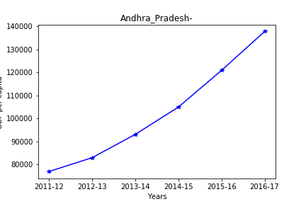
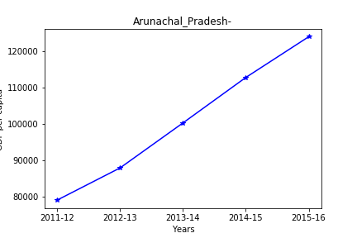
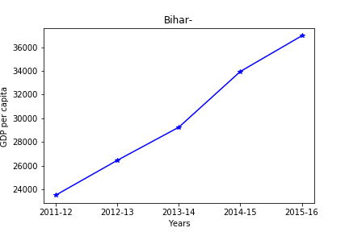
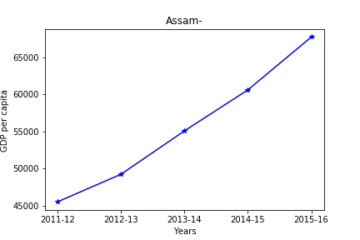
Part I-B: (GDP per capita for all the states)-1

Slide 15
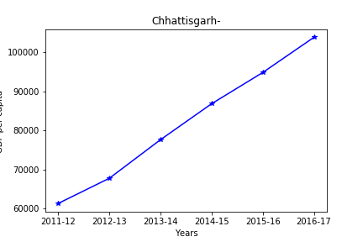
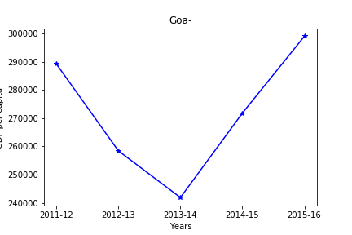
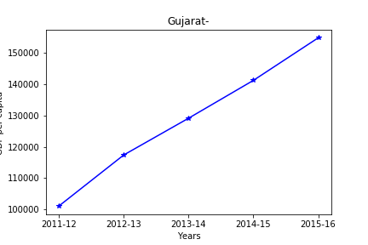
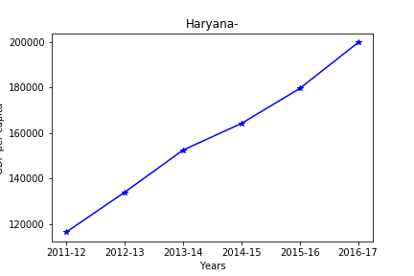
Part I-B: (GDP per capita for all the states)-2

Slide 16
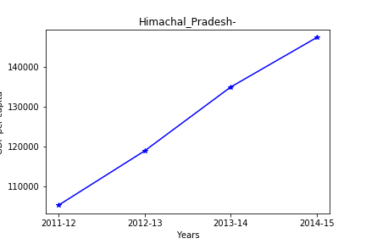
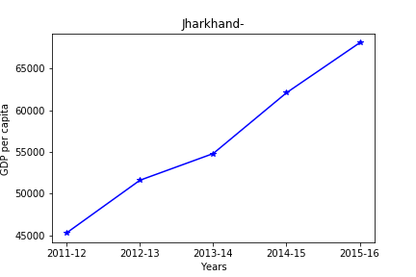
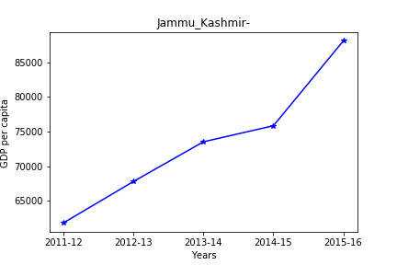
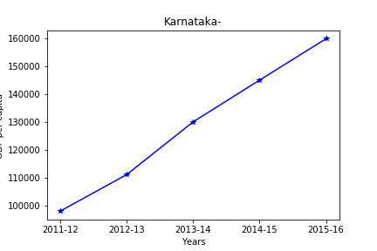
Part I-B: (GDP per capita for all the states)-3

Slide 17
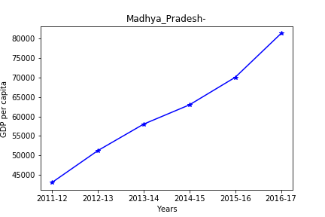
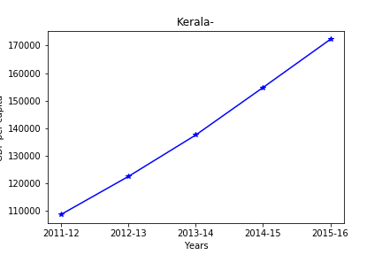
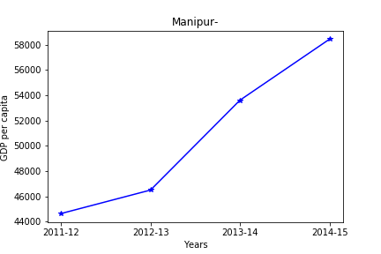
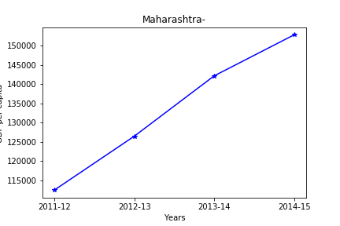
Part I-B: (GDP per capita for all the states)-4

Slide 18
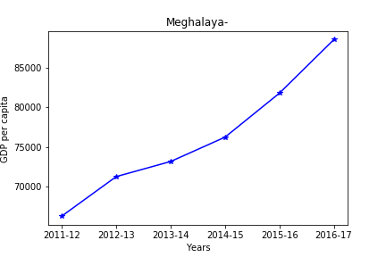
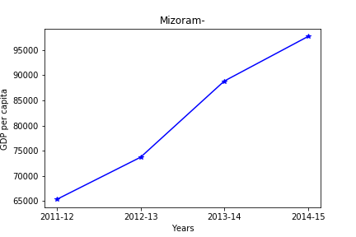
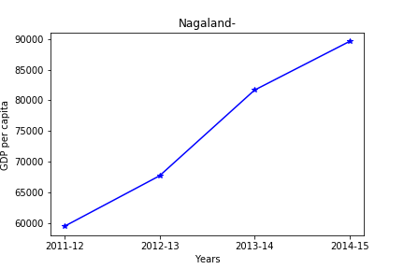
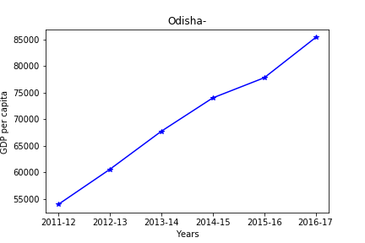
Part I-B: (GDP per capita for all the states)-5

Slide 19
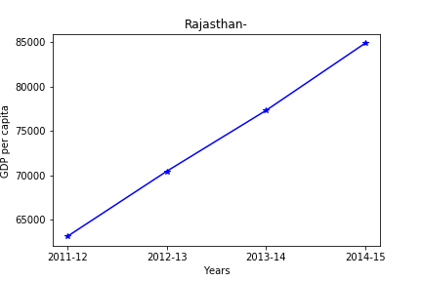
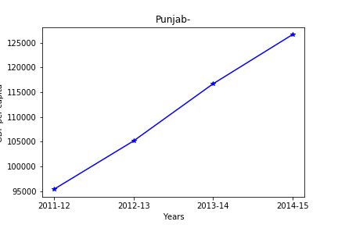
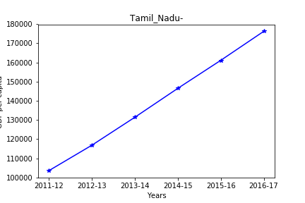
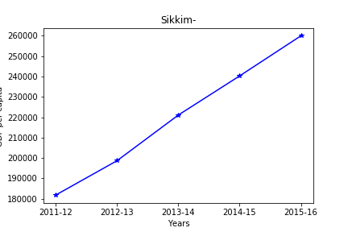
Part I-B: (GDP per capita for all the states)-6

Slide 20
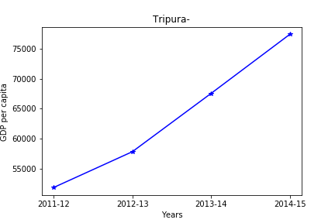
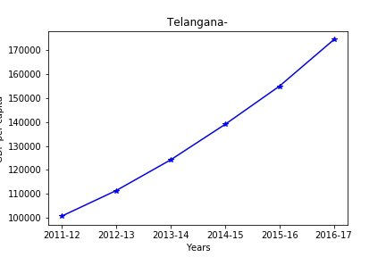
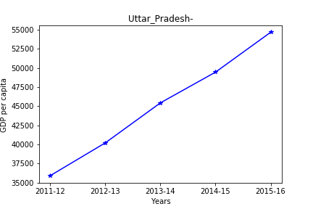
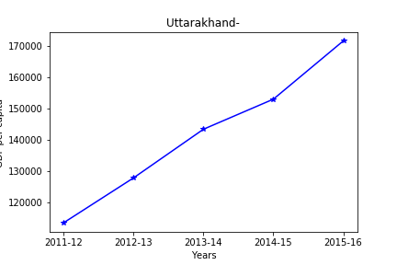
Part I-B: (GDP per capita for all the states)-8

Slide 21
Questions !!
Identify the top 5 and the bottom 5 states based on the GDP per capita.
Top 5
Andhra_Pradesh 616818
Arunachal_Pradesh 503727
Assam 278253
Bihar 150153
Chhattisgarh 492280
Last 5
Tamil_Nadu 835717
Telangana 804862
Tripura 254679
Uttarakhand 709847
Uttar_Pradesh 225663

Slide 22
Questions !!
Find the ratio of the highest per capita GDP to the lowest per capita GDP
Ratio of Andhra_Pradesh with Uttar_Pradesh
616818:225663=2.7333590353757593

Slide 23
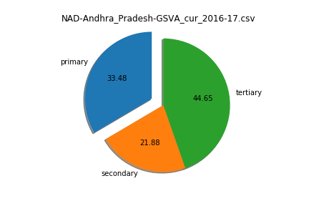
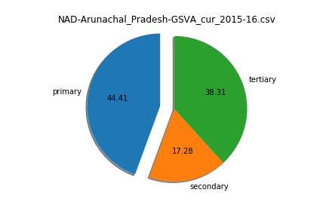
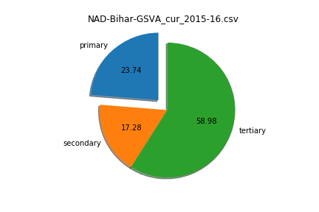
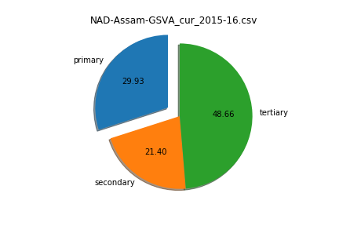
percentage contribution of the primary, secondary and tertiary sectors as a percentage of the total GDP for all the states. -1

Slide 24
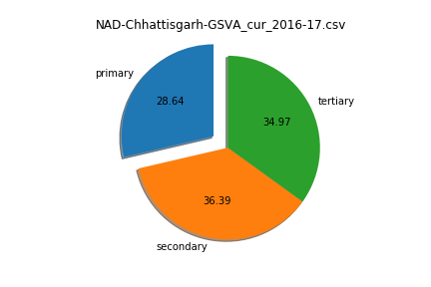
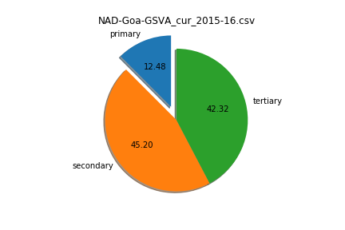
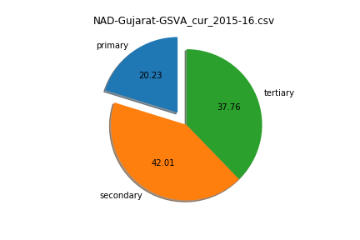
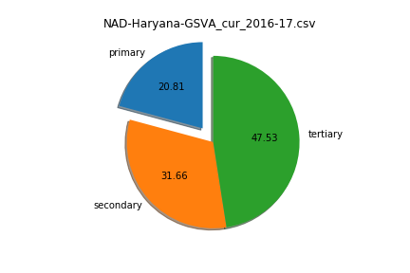
percentage contribution of the primary, secondary and tertiary sectors as a percentage of the total GDP for all the states. -2

Slide 25
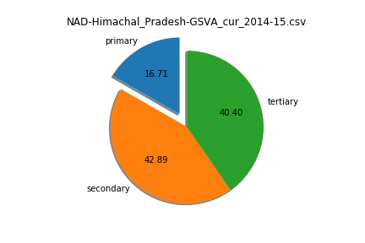
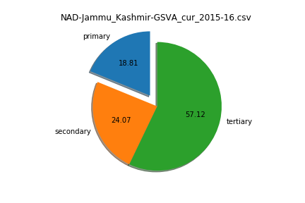
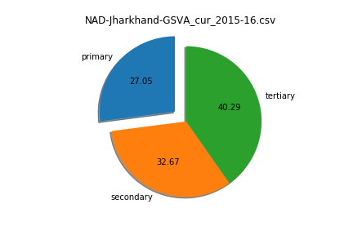
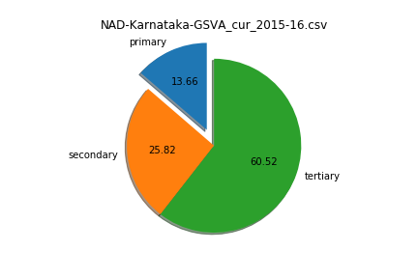
percentage contribution of the primary, secondary and tertiary sectors as a percentage of the total GDP for all the states. -3

Slide 26

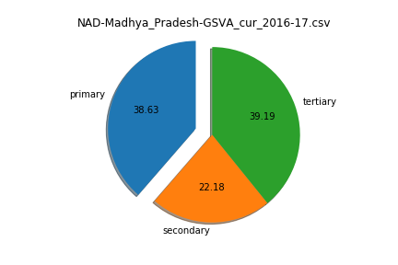
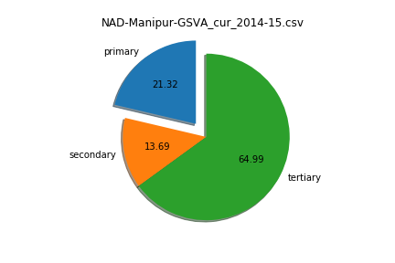
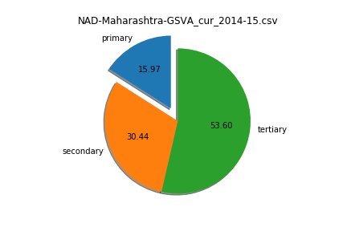
percentage contribution of the primary, secondary and tertiary sectors as a percentage of the total GDP for all the states. -4

Slide 27
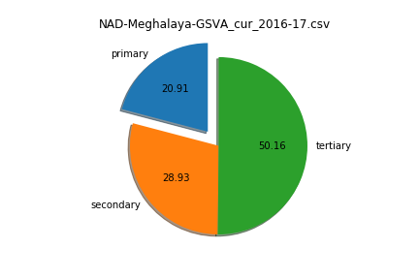
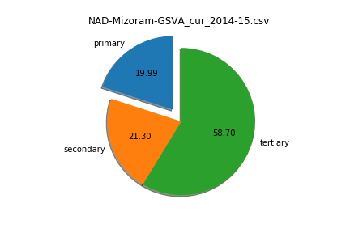
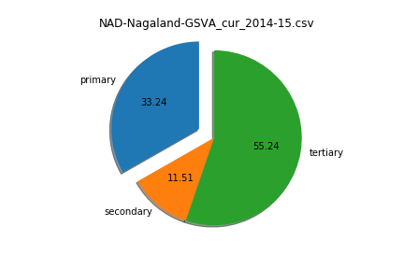
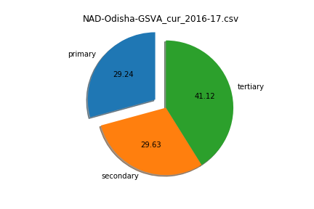
percentage contribution of the primary, secondary and tertiary sectors as a percentage of the total GDP for all the states. -5

Slide 28
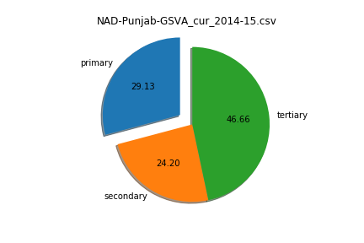
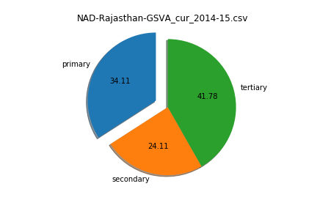
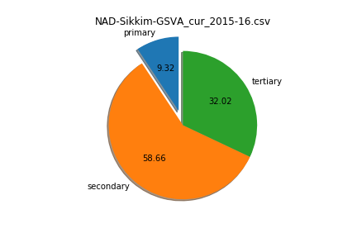

percentage contribution of the primary, secondary and tertiary sectors as a percentage of the total GDP for all the states. -6

Slide 29




percentage contribution of the primary, secondary and tertiary sectors as a percentage of the total GDP for all the states. -7

Slide 30
the top sub-sectors that contribute to approximately 80% of the GSDP of each category
States in category 1:
Assam,Bihar,Jharkhand,Manipur,Tripura,Uttar_Pradesh
States in category 2:
Jammu_Kashmir,Madhya_Pradesh,Meghalaya,Mizoram,Nagaland,Odisha,Punjab,Rajasthan
States in category 3:
Andhra_Pradesh,Arunachal_Pradesh,Chhattisgarh,Gujarat,Himachal_Pradesh,Karnataka,Kerala,Maharashtra,Uttarakhand
States in category 4:
Goa,Haryana,Sikkim,Tamil_Nadu,Telangana

Slide 31
the top sub-sectors that contribute to approximately 80% of the GSDP of each category
Category 1
Subsector : Agriculture, forestry and fishing
Contribution : 190516074.0
Subsector : Crops
Contribution : 126400795.0
Subsector : Trade, repair, hotels and restaurants
Contribution : 98056120.0
Subsector : Real estate, ownership of dwelling & professional services
Contribution : 97289273.0
Subsector : Manufacturing
Contribution : 94139557.0

Slide 32
the top sub-sectors that contribute to approximately 80% of the GSDP of each category
Category 2
Subsector : Agriculture, forestry and fishing
Contribution : 421213896.0
Subsector : Crops
Contribution : 286883608.0
Subsector : Manufacturing
Contribution : 201157828.0
Subsector : Trade, repair, hotels and restaurants
Contribution : 190693882.0
Subsector : Trade & repair services
Contribution : 177295168.0

Slide 33
the top sub-sectors that contribute to approximately 80% of the GSDP of each category
Category 3
Subsector : Agriculture, forestry and fishing
Contribution : 747445116.0
Subsector : Manufacturing
Contribution : 596526140.0
Subsector : Crops
Contribution : 490747080.0
Subsector : Real estate, ownership of dwelling & professional services
Contribution : 473801541.0
Subsector : Taxes on Products
Contribution : 426020857.75

Slide 34
the top sub-sectors that contribute to approximately 80% of the GSDP of each category
Category 4
Subsector : Agriculture, forestry and fishing
Contribution : 909365033.0
Subsector : Manufacturing
Contribution : 799492370.0
Subsector : Real estate, ownership of dwelling & professional services
Contribution : 665042163.0
Subsector : Crops
Contribution : 583666668.0
Subsector : Taxes on Products
Contribution : 558210586.75
Subsector : Trade, repair, hotels and restaurants
Contribution : 547263084.0

Slide 35

Plot the contribution of the sub-sectors as a percentage of the GSDP of each category(Category 1)

Slide 36

Plot the contribution of the sub-sectors as a percentage of the GSDP of each category(Category 2)

Slide 37

Plot the contribution of the sub-sectors as a percentage of the GSDP of each category(Category 3)

Slide 38

Plot the contribution of the sub-sectors as a percentage of the GSDP of each category(Category 4)

Slide 39
Questions !!
How does the GDP distribution of the top states (C1) differ from the others?
GDP per capita allows us to compare the prosperity of countries with different population sizes. Top states have more gdp than others.
Which sub-sectors seem to be correlated with high GDP?
1.Agriculture, forestry
2.Fishing
3.Crops ,Trade repair, hotels and restaurants
Which sub-sectors do the various categories need to focus on?
Air transport ,Water transport, Road transport

Slide 40

Part-II: GDP and Education
Any correlation of GDP per capita with dropout rates in education (primary, upper primary and secondary) for the year 2014-2015
Assumptions:
I have only taken states that are also in DATA-B
First column is GDP per capita
Second is dropout Rate of primary 2014-15
Third is dropout Rate of upper primary 2014-15
Fourth is dropout Rate of upper secondary 2014-15

Slide 41
one reasonable hypothesis for the observations from the data
Education is vital for economic development. According to Vision 2030 of World Economic Forum , “Education is key component of economic growth because it has directly influence on entrepreneurship, productivity growth and then increases employment opportunities and women empowerment. Education helps in making potential youth for the enhancement of ability, creativity and systematically skills to contest with the fast changing Global inclination. Students drop outs reduces literacy rate of country and non-innovative environment.

